Slide 1

Establishing branches of a restaurant

Slide 2
backstory
The purpose of the project is to find 3 places suitable for establishing 3 branches of a restaurant in NYC.
The RS company is looking for places which have high density, where can be near MTA stations.
People generally concern with this project.
Both entries and exits of MTA stations will be considered for determining the suitable places.

Slide 3
Tools dataset
Jupyter Notebook
SQLite
SQLAlchemy
Numpy
Pandas
Matplotlib
The chosen sample of the dataset includes three months of 2021, beginning from 2021/3/20 to 2021/6/25.

Slide 4
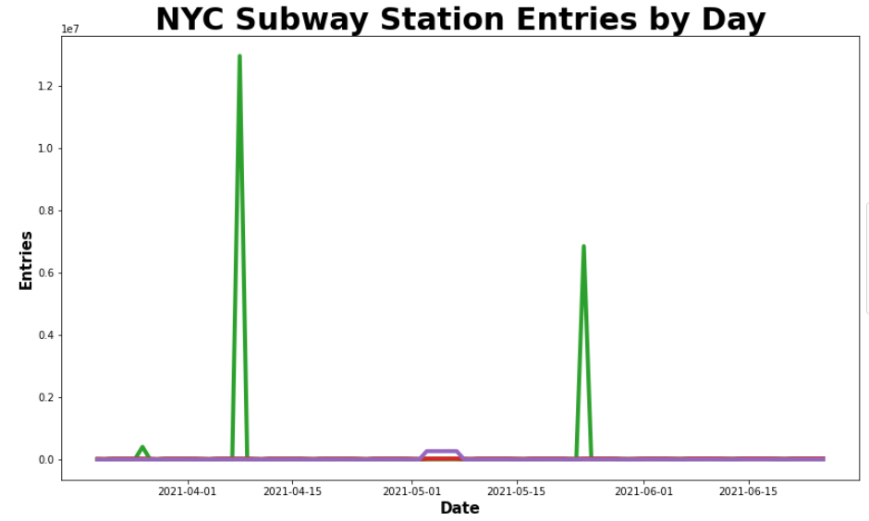
Data cleaning
Duplicate or unnecessary data
Inconsistent text and typos
Missing data
Outliers

Slide 5
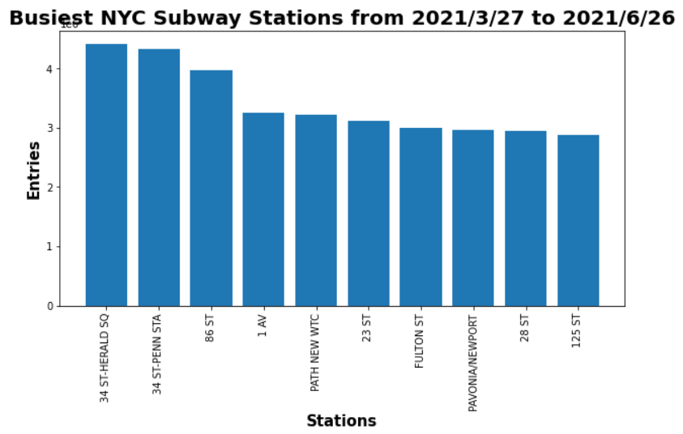
visualization

Slide 6
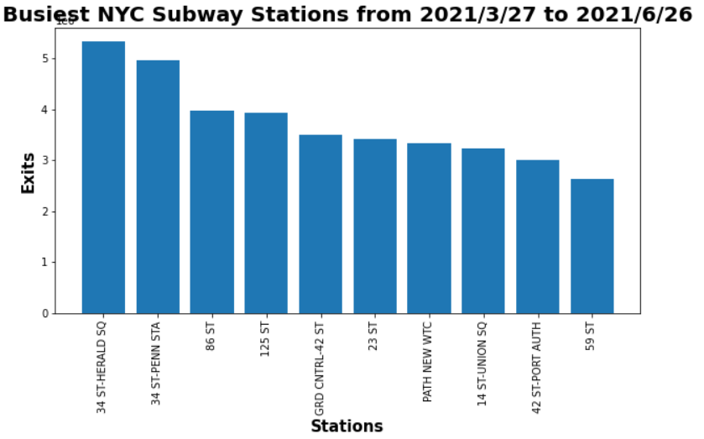
visualization

Slide 7
recommendationS
It is recommended that to establish the branches of the restaurant near the highest three stations in entries and exits, which are :
34 ST-HERALD SQ
34 ST-PENN STA
86 ST

Slide 8
Thank you for listening

